Slide 1

Post-Pandemic Workforce Study
Presented by Aeliya Fatima Syeda

Slide 2


Introduction & Context
Business Challenge
Data Overview
Work Patterns & Health Indicators
Predictive Modeling Insights
Recommendations
Impact Potential
Next Steps

Slide 3

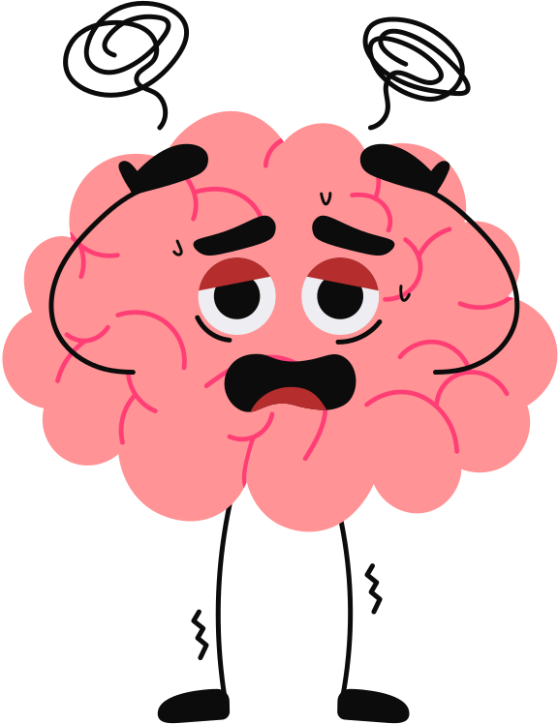
Executive Summary
The study highlights the significant obstacles businesses face in managing employee burnout effectively.
Burnout rates remain high post-pandemic, impacting productivity & retention.
Our analysis identifies key roles, regions, and factors linked to burnout risk.
Notes:
1. Burnout is concentrated in specific roles and work conditions (long hours + low flexibility + adverse mental-health signals).
2. It’s costly—driving avoidable productivity loss and attrition risk.
3. We can act now—limit peak workloads, expand flexible scheduling, and guide managers with risk signals. A pilot can show lift within one quarter.
Our model enables prioritization: who to help first, where to deploy resources, and how to track lift.” 33% HIGH AND 66% LOW

Slide 4


The Business Challenge
Burnout leads to:
Lower productivity (est. 15–20% drop in output)
Higher turnover (up to 2× attrition risk)
Increased healthcare & benefit costs
Notes:
Burnout causes a big (double-digit) drop in productivity, more sick days, and higher regrettable attrition. Replacing people is costly.
What this work does: Turns “well-being” into a clear, practical playbook with actions and metrics. Our goal is to build predective models and give strategies to control the burn out levels among employees

Slide 5
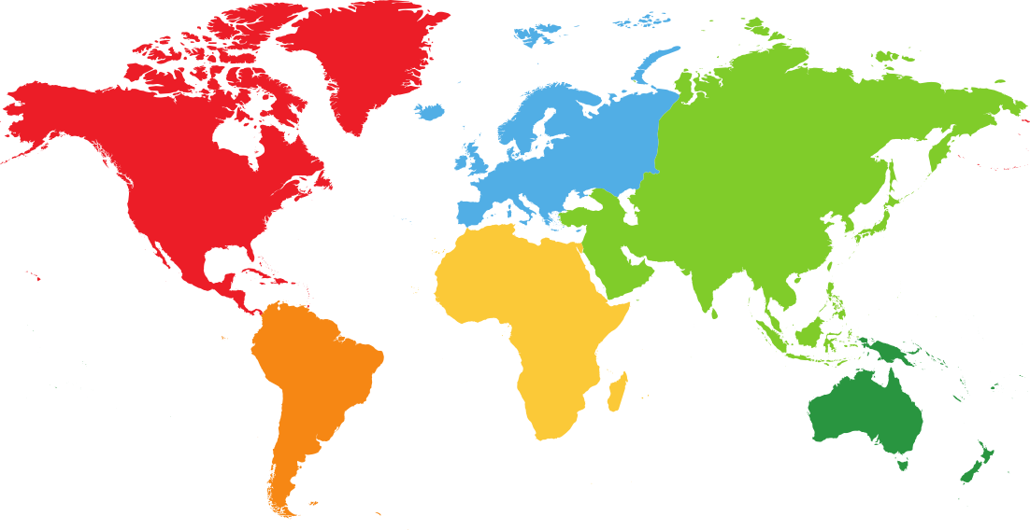

Data Overview
Dataset contains 3000+ employees from regions across the globe
Binary Target: High Burnout vs Low.
Features include:Work patterns: Hours, arrangement, flexibility
Health: Mental & physical health issues
Demographics: Age, gender, region, job role
Methods: Data cleaning, exploratory analysis, predictive modeling.
Notes:
The Post-Pandemic Remote Work Health Impact 2025 dataset presents a comprehensive, global snapshot of how remote, hybrid, and onsite work arrangements are influencing the mental and physical health of employees in the post-pandemic era. Collected in June 2025, this dataset aggregates responses from a diverse workforce spanning continents, industries, age groups, and job roles.

Slide 6
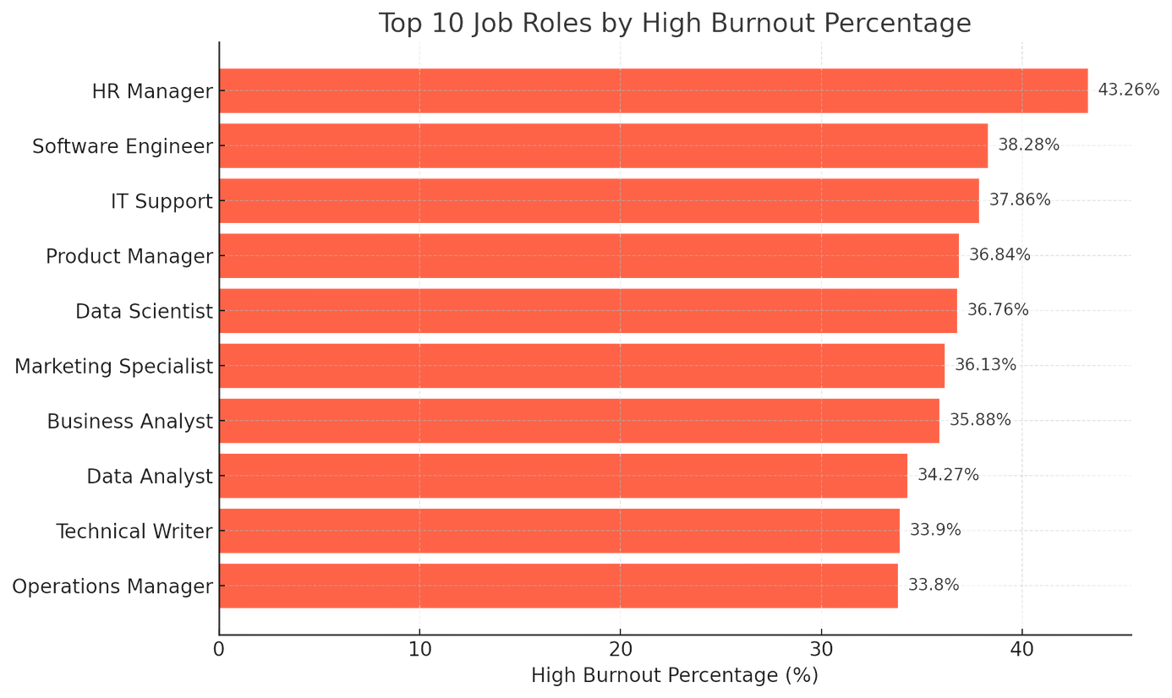
Burnout by Job Role
01
Understanding burnout across various positions
Different roles experience unique burnout levels.
02
Key factors contributing to burnout
Workload, expectations, and support matter significantly.
03
Strategies for burnout prevention
Tailored interventions can enhance employee well-being.
Notes:
certain roles trend above average. Typically, roles with high deadline pressure, customer exposure, or incident response show elevated burnout.
Interpretation: the job design itself (interruptions, after-hours work, backlog volatility) appears as a structural driver.

Slide 7
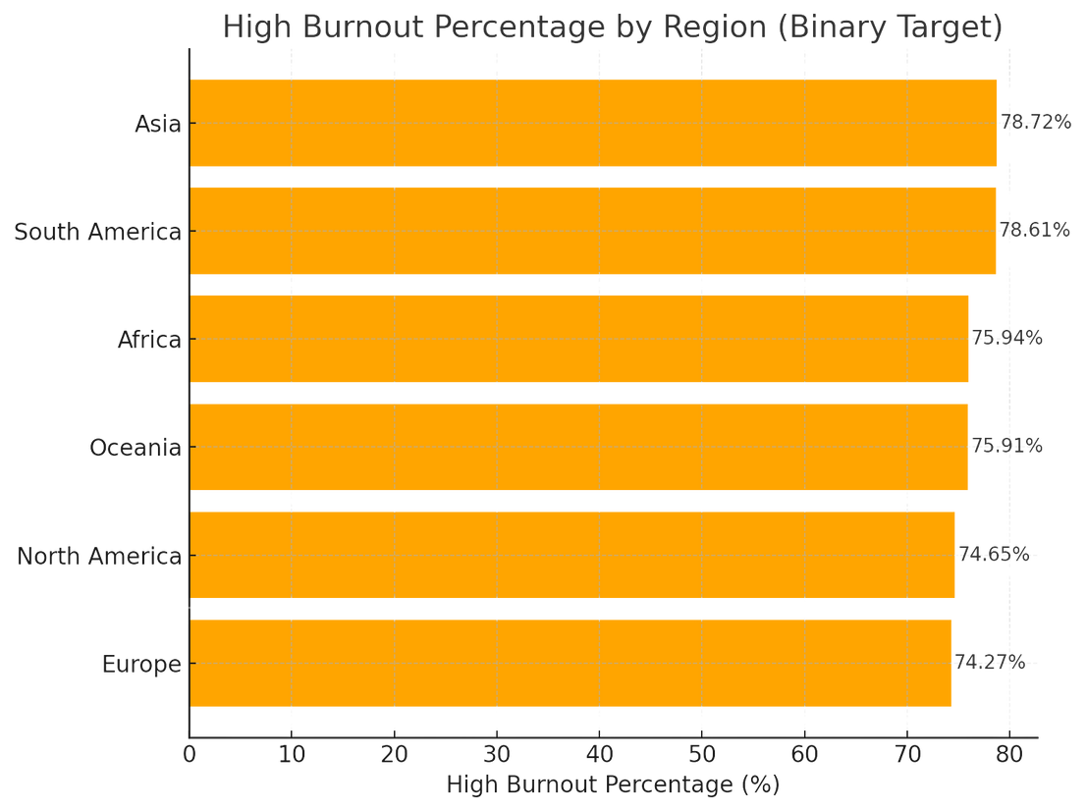
Burnout by Region
Impact of Location on Burnout Rates
01
Burnout is highest in Asia (78.7%) and South America (78.6%), but rates remain above 74% in all regions.
02
Factors contributing to burnout
This suggests cultural, economic, and operational factors are contributing
03
Strategies for improving policies
Emphasize that location-based policies may be necessary
Notes:
Regional differences likely reflect time-zone coverage, local leave norms, and management practices.”
“Where risk is elevated, we should validate drivers with HRBPs: e.g., are teams covering late-night overlaps, or is there understaffing?”
“Action: region-specific scheduling guardrails and reinforcement of time-off norms.
HRBPs = Human Resources Business Partners.

Slide 8

Burnout by Work Arrangement
Remote Work Impact on Burnout Levels
01
Remote workers report higher isolation and lower work-life balance despite the flexibility
Hybrid Work and Employee Well-being
02
Suggests that flexibility alone doesn’t guarantee well-being — social connection and boundaries matter.
03
In-Office Work Challenges
In-office employees face unique stress daily but they are less burnt-out when compared to remote employees.
Notes:
Work arrangement matters: mismatches between role demands and arrangement—e.g., on-site requirements paired with long commute times or remote roles lacking team cohesion—raise risk.”
“It’s not ‘remote vs on-site’ universally; it’s ‘fit for the work + flexibility to handle peaks.’”

Slide 9
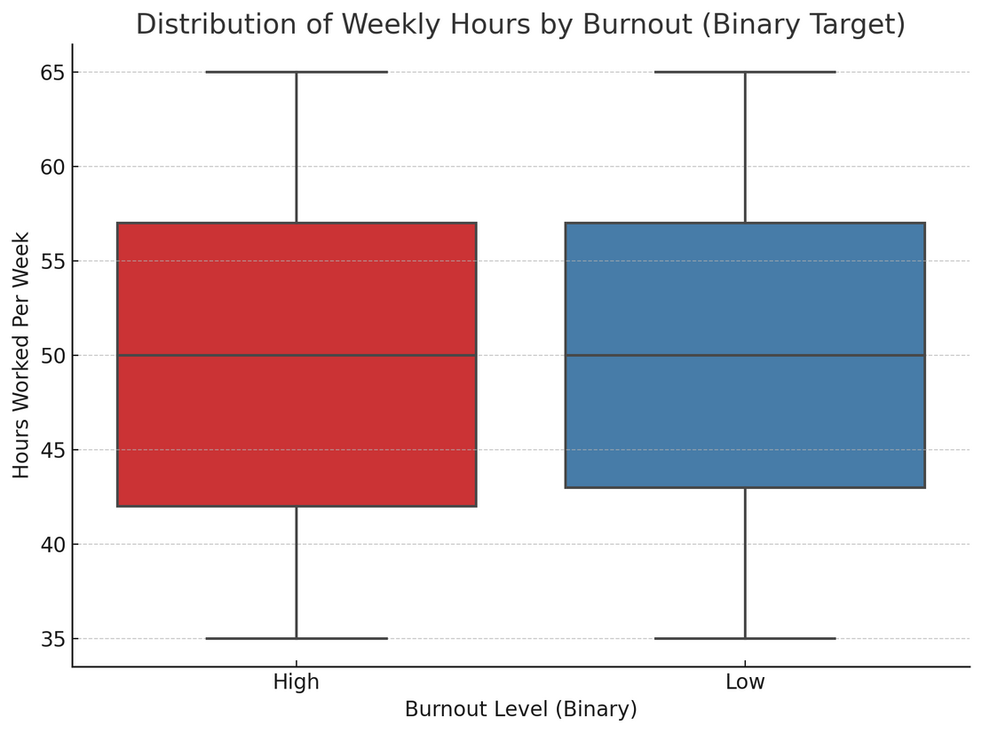
Burnout by Working Hours
01
Impact of Long Working Hours
Hours alone don’t explain burnout — variation is minimal between groups.
02
Optimal Work-Life Balance
Balancing work hours reduces burnout effects.
03
Flexibility in Scheduling
Flexible hours lead to lower burnout rates.
Notes:
Hours per week show a clear non-linear effect—burnout risk increases disproportionately past certain thresholds.”
“Weekend or late-night work compounds the effect, even if total hours look ‘normal.’”
“Action: set red-line thresholds (e.g., consecutive >X weeks above target hours) that trigger load balancing or manager review.”

Slide 10
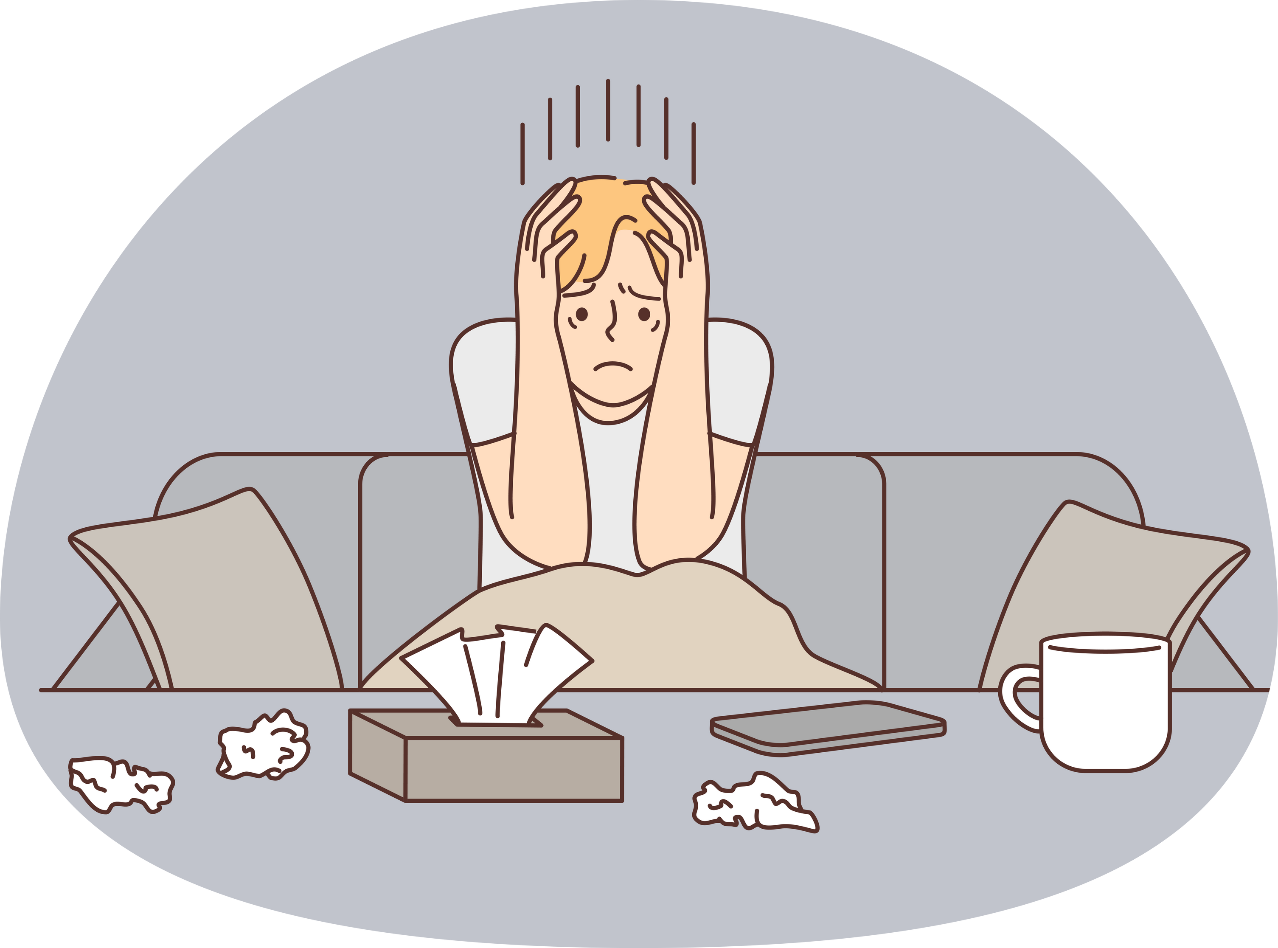
Mental Health & Burnout
PTSD – 13.14%
Stress Disorder – 12.56%
Anxiety – 12.52%
Depression – 12.35%
Burnout (self-reported) – 12.31%
ADHD – 11.44%
Other – 25.66%
These conditions directly affect focus, energy, and resilience — critical for sustained performance.
Notes:
Self-reported mental-health strain is among the strongest signals. When paired with high workload or low autonomy, risk escalates.”
“Stigma keeps some employees silent; our approach uses model-based pattern detection to surface risk without requiring disclosure.”

Slide 11
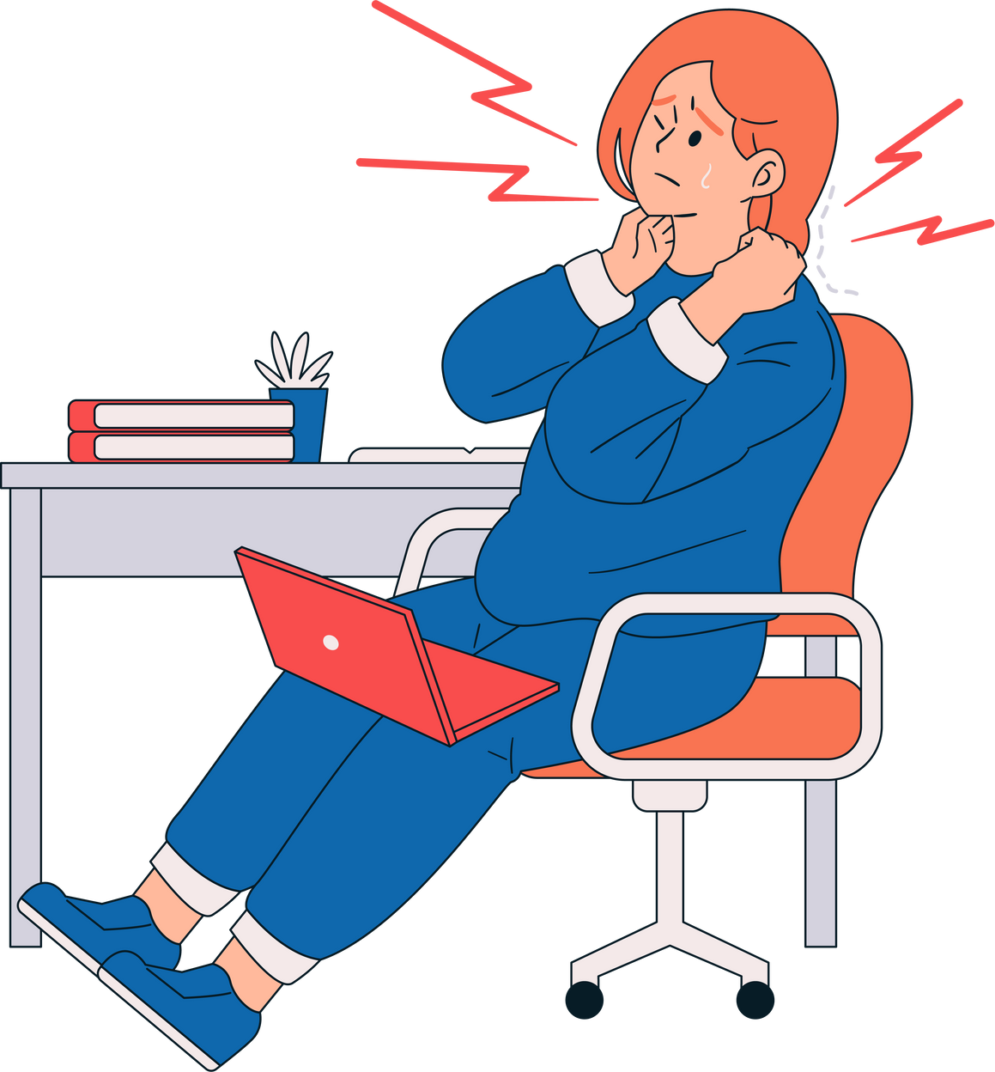
Physical Health Insights
Physical issues in High Burnout group:
Eye Strain – 51.33%
Back Pain – 49.42%
Shoulder Pain – 47.80%
Neck Pain – 25.17%
Wrist Pain – 14.76%
These symptoms align with screen-heavy, sedentary work — especially remote/hybrid setups.
Notes:
Physical health issues and poor sleep quality correlate with higher burnout—especially where schedules disrupt recovery time.”
“Action: nudges for recovery windows after late shifts, discourage back-to-back late/early days, and coordinate with benefits to promote preventive care.

Slide 12


Social & Work-Life Balance
High burnout employees show lower work-life balance and greater social isolation.
Even small shifts in these scores can tip employees into burnout, making them critical early warning signs.
Addressing connection and workload boundaries can reduce risk quickly.
Notes:
Low team support, low perceived fairness, and unmanaged context-switching are risk multipliers.”
“Small changes help: predictable ‘no-meeting’ blocks, clarified priorities to reduce thrash, and buddy systems in high-pressure roles.”

Slide 13

Predictive Modeling top predictors
Job Role – Certain roles, such as HR Managers and IT Support, carry disproportionately high risk.
Region – Asia and South America have the highest burnout rates.
Mental Health Status – Conditions like stress disorder, anxiety, and depression strongly correlate with high burnout.
Work-Life Balance Score – Lower scores consistently align with higher burnout risk.
Work Arrangement – Remote workers have the highest burnout levels at 86%
Notes:
Top predictors consistently included: Hours/Week, Mental-Health status signals, Work Arrangement/Flexibility, Sleep/Recovery, and Manager-related indicators.”
“The model doesn’t predict the future perfectly—it helps us prioritize where managers should look first. it flags the employees and teams most likely at risk so leaders can act sooner. accuracy ≈ 0.7287 and ROC-AUC ≈ 0.8941
RAN 5 MODELS and RANDOM FOREST can rank employees/teams by risk so managers focus on the top-risk employees
“The Random Forest ranks where burnout risk is highest and highlights why—role/arrangement/context, not just hours—so we can target fixes.”
“We’ll use that ranking to pilot guardrails, flex, and manager routines in the highest-risk teams and track a 3–5 point drop in high-burnout before scaling.” WHY ROC “ROC tells us how good our model is at sorting high-risk ahead of low-risk and where to set the alert threshold to catch more real cases without too many false alarms
AGE GROUP BURNT OUT MOST 65+ → 40.5%
25–34 → 34.2%
35–44 → 34.0%

Slide 14


Recommendations
Mental health support programs — counseling, stress management workshops, and stigma-free access to care.
Ergonomic and eye health interventions — addressing top physical complaints (eye strain 51%, back pain 49%, shoulder pain 48%).
Quarterly monitoring of Work-Life Balance and Social Isolation scores to detect early signs of burnout and intervene before escalation.
Notes:
We segment employees into risk tiers (e.g., top 10–20% as ‘high-risk’).”
“Playbook:
Team-level heatmaps for leaders to see hotspots;
Manager prompts: ‘check workload distribution, clarify priorities, offer flex’;
Employee-facing options: schedule adjustments, time-off planning, or access to support.”
“Guardrails: we treat outputs as directional, not deterministic—human review is essential.” Action- focus early pilots on the top-risk roles with tailored workload caps and manager coaching.”

Slide 15
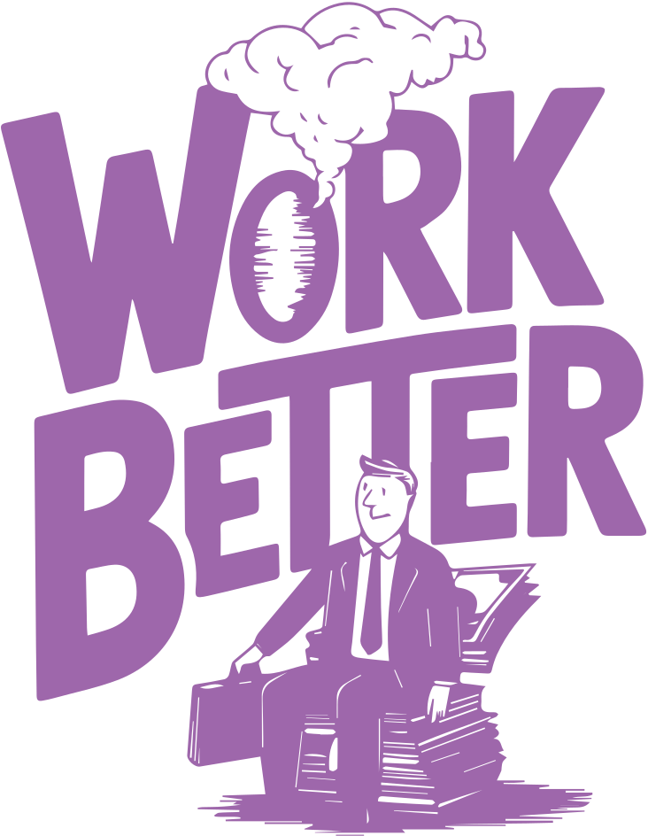
Impact & Next Steps
Impact Potential: Implementing these targeted actions could reduce burnout by 10–15% in the first year, driving measurable gains in employee retention, lowering healthcare costs, and improving productivity.
Next Steps: Integrate burnout scoring into HR dashboards for real-time risk tracking.
Pilot targeted programs in high-risk roles and regions, focusing on both mental and physical health.
Measure and adjust based on quarterly engagement and burnout metrics.
Call to Action: Decide today on the pilot scope so we can move into implementation and start reversing burnout trends within the next quarter.
Notes:
We’ll reduce sustained peak weeks, add micro-flex, equip managers, and protect recovery time—then prove it in an 8-week pilot in our highest-risk teams Our HRBPs will partner with managers to run the pilot, enforce guardrails, support high-risk cases, and make sure interventions are fair, private, and compliant-Human resource business partners.
RANDOM FOREST can rank employees/teams by risk so managers focus on the top-risk employees
“The Random Forest ranks where burnout risk is highest and highlights why—role/arrangement/context, not just hours—so we can target fixes.”
“We’ll use that ranking to pilot guardrails, flex, and manager routines in the highest-risk teams and track a 3–5 point drop in high-burnout before scaling.”

Slide 16



Notes:
Our HRBPs will partner with managers to run the pilot, enforce guardrails, support high-risk cases, and make sure interventions are fair, private, and compliant

Slide 17

APPENDIX

Slide 18
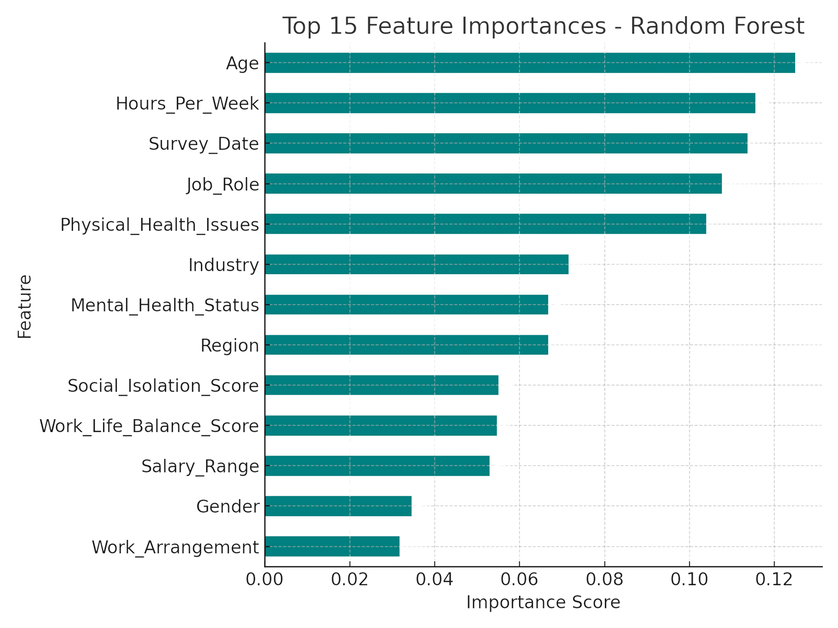
Notes:
RANDOM FOREST can rank employees/teams by risk so managers focus on the top-risk employees
“The Random Forest ranks where burnout risk is highest and highlights why—role/arrangement/context, not just hours—so we can target fixes.”
“We’ll use that ranking to pilot guardrails, flex, and manager routines in the highest-risk teams and track a 3–5 point drop in high-burnout before scaling.” “ROC tells us how good our model is at sorting high-risk ahead of low-risk and where to set the alert threshold to catch more real cases without too many false alarms

Slide 19
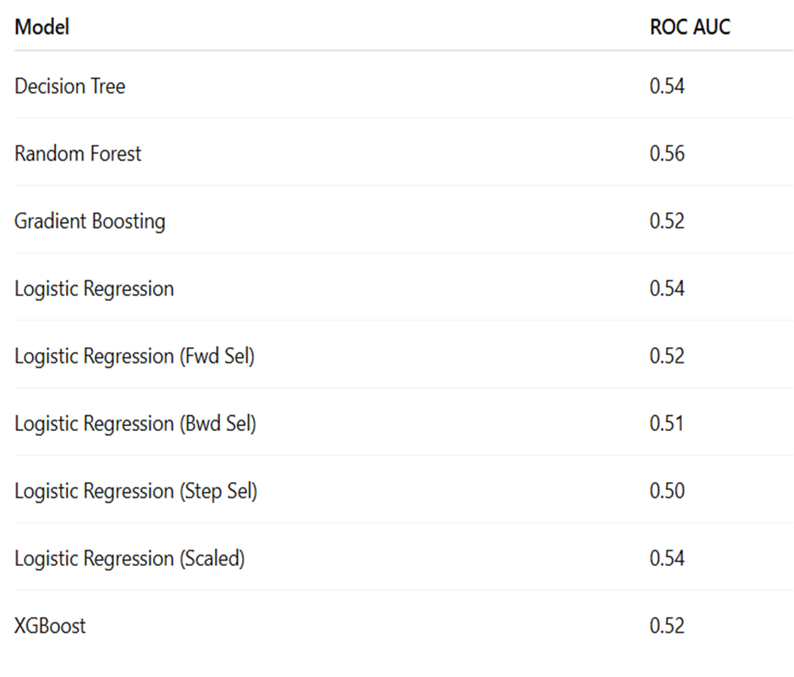

Notes:
Top performer Random forest with accuracy ≈ 0.7287 and ROC-AUC ≈ 0.8941 Random Forest: An ensemble of many decision trees that each vote; the forest’s majority/average gives a more stable, less overfit prediction and captures non-linear patterns.
Accuracy: The percent of predictions that are correct on the test set (overall correctness).
ROC-AUC: How well the model ranks true positives above negatives across all thresholds
higher AUC means your model is better at ordering employees by burnout risk, so managers can prioritize who to check in with first

Slide 20
